Slide 1
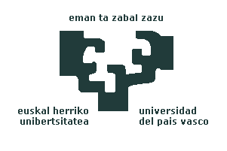

Experiments on Trust Prediction based on reputation features
J. David Nuñez-Gonzalez
Manuel Graña

Slide 2
Index
1.- Introduction
2.- Trust related definitions
3.- Experimental Database
4.- Feature extraction
5.- Computational Experiments
6.- Results
7.- Conclusion

Slide 3
1.- Introduction
RISK
uncertainy about results
we expect
MAKE A DECISION
unknown consecuences
Based on
INFORMATION SOURCES
that we
TRUST
built in
FEEDBACK PROCESS
good results
bad results
TRUST + +
TRUST - -

Slide 4
2.- Trust related definitions I
the degree of subjective belief about the behaviors of a particular entity.
the quantified belief by a truster with respect to the competence, honesty, security, and dependability of a trustee within a specified context.

Slide 5
2.- Trust related definitions II
Properties
  Transitivity, asymmetry,
  Subjectivity, context-dependency
  Reflexivity, non antisymmetric
Reputation systems
  Collaborative Filtering
  Collaborative Sanctioning

Slide 6
3.- Experimental Database
Wikipedia’s Vote Network
Built Database
elector promotion | time election | considered user for promotion | nominator user | vote
user who give vote | voted user | Vote
78.83%
21.17%

Slide 7
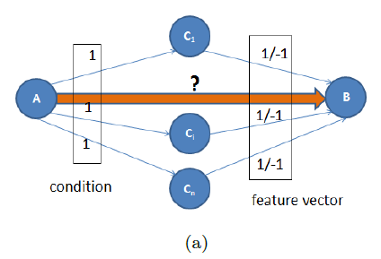
4.- Feature extraction
First set of features (a)

Slide 8
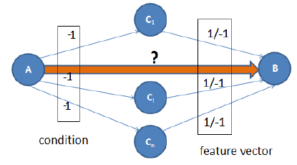
4.- Feature extraction
First set of features (b)

Slide 9
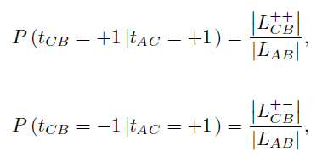
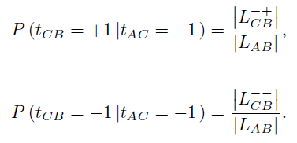
4.- Feature extraction
First set of features (a+b)
a
b

Slide 10
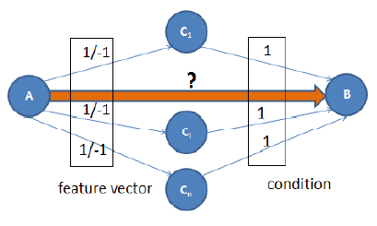
4.- Feature extraction
Second set of features (c)

Slide 11
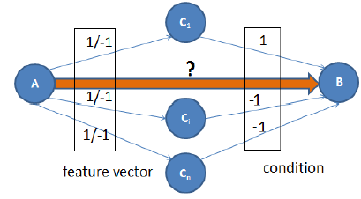
4.- Feature extraction
Second set of features (d)

Slide 12
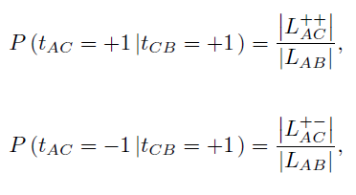
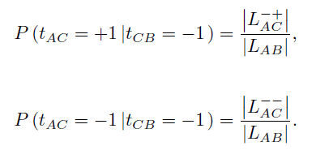
4.- Feature extraction
Second set of features (c+d)
c
d

Slide 13
5.- Computational Experiments
1st experiment: First set of features
2nd experiment: Second set of features
3rd experiment: First + Second set of features

Slide 14
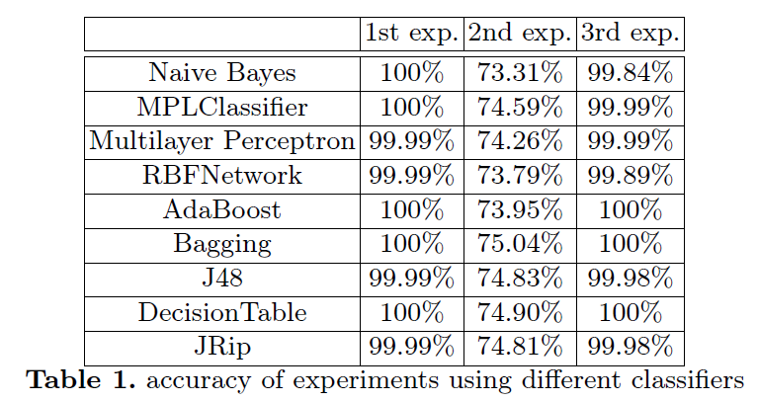
6.- Results

Slide 15
7.- Conclusion
Calculation of probabilities in a trust reputation system achieves the best accuracies.
The robustness of this features is demonstrated on 3rd experiment.

Slide 16
Thank You

