Slide 1
Publishing Scientific Research
July 1, 2014 – Bilbao - Joint Meeting
Francesca Bonadei
Executive Editor
Mathematics and Statistics @ Springer Italia

Slide 2
Agenda
Why should you publish?
Journals
Books
Some interesting aspects with Springer
Notes:
JOURNALS
How to structure your article
How to choose the right journal
When you submit
Submission considerations – ethics
How is the Impact Factor calculated?
What is peer-review, why is it important and how to deal with the feedback
Open access versus traditional publishing
What is ‘Online First’
Books
Springer helps you from A to Z

Slide 3
1842-2014
Milan

Slide 4
Why should you publish?
Present new and original results or methods, exchange ideas, communicate with peers.
Advance (not repeat) scientific knowledge, enhance scientific progress.
Grant writing, research funding.
Recognition and career advancement.
Personal prestige, satisfaction and enjoyment.
Credibility of results.
Why not just blog about it?
Scientific publishing = driving progress.
  Quality control
  Professional publishing services (Abstracting & Indexing for example)
  State of the art technology
  Global marketing, global visibility
Notes:
you need to be able to explain your results, your findings and what they mean to a global research audience. And it needs to be done so that your work is easily understandable to a reader. Scientists, researchers in general are curious people, that’s why they do what they do. You need to exchange your ideas at a global level so that other people are aware of what you’ve done and there is a permanent record and so that it’s not unnecessarily repeated.
HOWEVER, to effectively share your findings with the world, clear language is NECESSARY and CRITICAL!
And if you haven’t been told this previously, you need to know that your research ISN’T ACTUALLY COMPLETE until it’s been published! You may do good science, but if you don’t get it published then really it’s only a hobby.
publish or perish means that if you want to continue as a researcher in any field, you need to publish your work so your peers can review and critique your work. Getting published will help you with your grant writing and increase the chances of you getting funded. You need to be able to write strong grant applications as well as journal manuscripts. And once you get funded, you can employ other researchers and continue to do experiments in the areas you are interested in and publish more articles.

Slide 5

Why publish in English?
The international language of science
Other scientists WANT to hear from local scientists
Allows you to become an effective science communicator
Your number of publications is linked to career
advancement and funding success
Notes:
[Remember to insert the correct nationality of the audience you are talking to in this slide]
Now I know it may seem unfair and it can be difficult for people whose first language isn’t English but right now, in the world today, English is the international language of science. So it is extremely important that you write manuscripts that can be submitted to English peer-reviewed books/journals. Be aware that other scientists want to hear from local scientists. They know that lots of good science is happening here and they want to hear about it. Scientists are curious people!
Also, publishing in English allows you to become a very effective science communicator because you suddenly have a much wider audience that you can reach than if you publish in your native tongue.
Of course, the number of publications you have is directly related to your career advancement and funding success. The majority of the world’s best journals are published in English, so it only makes sense that if you want to advance your reputation as an expert in a particular field you need to publish in these English journals.

Slide 6

Books vs. Journals
Academic books have a different purpose from academic journals
An academic book is a complete scholarly work on a specific topic
Book chapters fulfil a similar role to review articles, with books representing a collection of manuscripts on related topics
These are published together under a book title that unites the collection
By contrast, review articles published in journals are usually unrelated to all of the other articles in the same issue
They are published because they are timely
and the journal editors believe a review is warranted
Notes:
Both books and journals useful information to scientists on a topic. But they each have a different purpose.
Academic books tend to be a complete work on a very specific topic. Whilst a journal is an ongoing publication that publishes primary research papers.
It can be said that books can represent a collection of manuscripts on related topics. These are then published together under a title for the book that unifies the collection.
In contrast to this, when you see a review article in a journal, it is highly likely that it will be unrelated to the other articles that have been published in the same issue. Review article in journals are published because they are timely and the editors of the journal believe that a review is needed. Maybe because there is a lot of published material that needs to be united. Or it’s a new and emerging field where a lot of publications have been produced in a very short space of time.
Why would you publish in a journal?
Well, because your results are new and exciting. You can get your work published quickly, much quicker than if you were writing a book or book chapter.
There is already an established readership for the journal. Your work is unlikely to be a complete picture, instead it’s only small piece in a much larger puzzle.
Journals also accept various types of manuscripts, whether it’s a short or rapid communication, or a full article.
AQ: COMMENTA CHE PUBBLICARE SULLE RIVISTE INTERESSA TUTTI MENTRE PUBBLICARE SUI LIBRI NO. INOLTRE LA SCELTA DIPENDE ANCHE DALLE AREE….

Slide 7
Journals - Increased competition
Relative growth from 100% baseline in 1990
Notes:
Now this graph shows you the competitive nature of manuscript publication. The blue line indicates the increase in journal numbers form 1990 to 2008. It is approximately a 3% increase each year. Now the red line shows the increase in the numbers of manuscripts submitted to journals – these has been increasing at a rate of 10-12% each year. So you can see there is now a massive difference in the numbers of journals available and the manuscripts submitted to them. What does this mean for you? Well, basically it is even more difficult now for you to get published because of all the competition out there. So you need to write the very best manuscript possible, and IT HAS TO BE in clear and concise English so that it is easy for journal editors and peer reviewers to understand. This will help increase the chances of your manuscript being accepted for publication.

Slide 8

    Before you start
“The origin of a research investigation is typically a moment of insight” (Justin Zobel) – Trust your instincts and if you think a topic deserves attention, then take it forward.
To write = to read. Research the topic, check out what is currently being published. What are the ‘hot’ topics, the emerging areas, the key themes, the relevant conferences and so on.
Make the decision about where to submit your paper before you complete your paper. That way you can ensure that the content and style fit the Aim & Scope of the journal.
Notes:
COMMENT FOR JUNIOR RESEARCHERS

Slide 9

What do journal editors want?
Good quality science!
Original research
Interesting to the journal’s readership fitting the AIMS&SCOPE
Clear, concise writing
Notes:
[replace image as appropriate to audience]
So what do journal editors want, and look for, in the many manuscripts that are submitted to them everyday?
Having talked to many journal editors, and publishers, the common thing that ALL of them say when asked what they want in a journal manuscript, it’s GOOD QUALITY SCIENCE. The basis of this, of course, is a good study design.
They want manuscripts that will stand up to peer review.
A manuscript has to contain original and new research that advances an area of research – in other words, it has to be original.
Your manuscript needs to be interesting to the people, the specific audience, that read the journal. It helps if you’re working in an active research area, a hot topic, some outstanding or new field that has lots of citations associated with it.
Another common thing that journal editors like to see is CLEAR AND CONCISE writing. Manuscripts that are logical and easy for them to understand. If there are language problems with a manuscript, it becomes difficult for an editor or a reviewer to understand what you mean and makes it more difficult for them to assess your research results.

Slide 10
    How to choose the right journal
How important are the following factors for you when deciding to submit a manuscript to a particular journal?
Top 1 Box (very important; in percent)
The journal's reputation
Quality of journal's papers
Quality of peer review
International scope
Speed of publication
Impact Factor
Electronic submission system
Coverage by major A&I
Readership
Advanced online publication
Editors / editorial board
Prior experience with this journal
Design / layout
"Author pays" open-access model
(N = 19,220 respondents, 5-point rating: 1=very important to 5=not important at all) Results 2009

Slide 11
    How to choose the right journal (cont.)
Read the journal product page and READ THE JOURNAL.
Talk to your colleagues /peers about their experiences with journals you are considering.
Make use of the expertise of your Library staff.
Check out the websites of research groups and researchers working in your research area, and see where they have been publishing their research. How visible has their research been? Has it been well cited?
Is an Impact Factor Important to you?
Follow the references that these research papers use. Where were the original papers published and read?
Join other relevant online groups and forums.

Slide 12
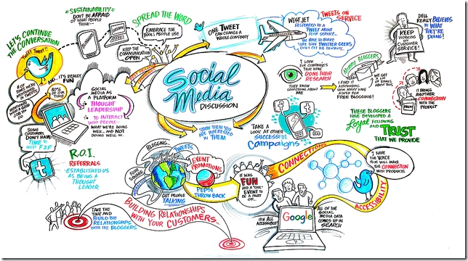
    How to choose the right journal (cont.)
Use the digital libraries, Abstracting & Indexing (A&I) services, Online Archives, etc.
Check publisher sites, you can often find useful information in the ‘for authors’ section.
Avoid journals with no clear submission and reviewing process.
Don’t miss the importance of social networking sites. E.g. on LinkedIn there is bound to be a discussion group dealing with the topic of your research area. If not, start one. Or think about setting up separate facebook pages for your academic connections.
Notes:
AQ: COMMENTS? IN MATE CI SONO RIVISTE PRESTIGIOSE CON IF BASSO E VICEVERSA CON RIVISTE CON IF GONFIATO X MANIPOLAZIONI SU CUI NON CI SONO VANTAGGI SIGNIFICATIVI X PUBBLICARCI

Slide 13
Top 20 journals with Springer
Title | 2013 Downloads | Ranking Downloads | Rejection Rate 2013 | 2012 Impact Factor | Ranking IF | 2012 - 5Yr Impact Factor
Acta Mathematica | 102.926 | 10 |  | 2,714 | 1 | 3,650
Journal of Mathematical Biology | 122.901 | 7 | 78% | 2,366 | 2 | 2,733
Inventiones mathematicae | 383.479 | 1 |  | 2,259 | 3 | 2,829
Mathematical Programming | 202.100 | 3 | 72% | 2,090 | 4 | 2,351
Bulletin of Mathematical Biology | 118.243 | 8 | 57% | 2,023 | 5 | 2,105
Foundations of Computational Mathematics | 34.703 |  |  | 1,918 | 6 | 2,863
Publications mathématiques de l'IHÉS | 39.488 |  |  | 1,867 | 7 | 2,294
Journal of Scientific Computing | 76.756 | 14 | 58% | 1,710 | 8 | 1,828
Optimization Letters | 47.514 |  | 81% | 1,654 | 9 | 1,602
Geometric and Functional Analysis | 37.915 |  |  | 1,574 | 10 | 1,577
Journal of Nonlinear Science | 24.555 |  | 87% | 1,566 | 11 | 2,026
Fuzzy Optimization and Decision Making | 22.320 |  | 93% | 1,488 | 12 | 1,814
Journal of Heuristics | 37.232 |  | 85% | 1,471 | 13 | 1,795
Advances in Computational Mathematics | 41.269 |  | 83% | 1,468 | 14 | 1,305
Journal of Optimization Theory and Applications | 219.955 | 2 | 69% | 1,423 | 15 | 1,475
Probability Theory and Related Fields | 114.811 | 9 | 79% | 1,394 | 16 | 1,544
Mathematische Annalen | 166.105 | 4 | x | 1,378 | 17 | 1,299
Numerische Mathematik | 133.283 | 5 |  | 1,329 | 18 | 1,668
Computational Optimization and Applications | 71.584 | 15 | 79% | 1,278 | 19 | 1,560
Calculus of Variations and Partial Differential Equations | 51.826 |  |  | 1,236 | 20 | 1,213

Slide 14
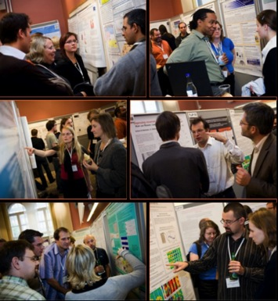
Hot topics
Talk to other scientists!
Local society meetings
National conferences
International congresses
These are the places where the
very latest results are presented
Notes:
But, BY FAR, I think the best way to find out what hot topics are is to talk to other scientists.
Network!
Become involved by joining a society and going to their local and regional meetings.
Attend national conferences and present your work. Apply for scholarships and try to attend international congresses whenever you can.
These are THE PLACES where the very latest results are presented, before they are even ready for publication. Scientists like to show off to other scientists and demonstrate their latest findings.
By going to conferences and congresses you can perhaps meet the leaders in your field and discuss your work. It’s a great way to get tips from leading scientists and discuss science in general.

Slide 15

    Types of journals
Traditional academic research journal – Main venue for primary research, rigorously peer-reviewed.
Review journal – Covers current trends, usually peer-reviewed, contains some commissioned material.
Letters journal – Rapid communication of interim work, peer-reviewed, a good way to get very new and ongoing research initially published.
Notes:
REVIEW: ES ACTA NUMERICA

Slide 16
    How to structure your article
Title – This will be read first and most. Does the title reflect the content of the paper? Keep the title short and to the point.
Abstract – Summarize the objective and the results of your research in 75 to 200 words. Whoever reads your paper should be able to tell at a glance what the article is about and what the outcome is. What are the key take-aways for your paper. Do not include anything that is NOT in your paper.
Keywords – The words relevant as search terms in e.g. Google. Ideally they are not words from the title because the words in the title are automatically used as keywords already.
Introduction – Explain (1) why the research was conducted, (2) what methodology was employed, (3) why you chose your particular methodology, and (4) how the methodology accomplished the hypothesis set out in your abstract. Explain (5) which are your (original) achievements.
Notes:
MOSTLY FOR BEGINNERS!!
The title. This is the first thing that people will see when searching the various databases. The title needs to get the attention of the reader, it’s a way of introducing your manuscript to a journal editor and it is going to be a label for indexing of your published article.
Your title should convey the main topics within the manuscript, but at the same time be specific and concise. There is normally a limit to the length of proposed manuscript titles. It is also best to avoid jargon (highly technical words), abbreviations and acronyms unless they are well established in the field.
The signs of a good abstract are:
It is brief, usually because of the word limits that journals enforce. The length of an Abstract can vary from only 100 words to maybe up to 500 words. It will depend on your target journal.
The objectives and scope of the study have been defined.
The methods used have been very briefly mentioned.
The most important results, not necessarily ALL the results, have been summarized.
And the major conclusions that you have come to based on your results have been clearly stated.
Again, similar to the title, avoid abbreviations unless absolutely necessary or well established in the field. And you normally avoid including references in the Abstract – but again, that is dependent on your target journal and their requirements.
Make sure you choose key words that are appropriate for indexing. Effective key words make it easier for your published article to be found. The more people that read your work, will lead to an increase in the number of times your work is cited.
I find it’s always best if you use established key words and terminology from the literature and also key word databases such as MeSH and PACS.
Try to avoid general terms where possible – as your article will likely get lost amongst all the other articles previously published in that broad area.
Be aware that some journals DO NOT ALLOW key words in the title of your manuscript – so once again I say, consult the guide for authors for your target journal.

Slide 17
    How to structure your article (cont.)
Body of the paper
This should be written clearly and concisely so that someone who wanted to conduct similar research would know exactly what you did.
Present your results rigorously, clearly and carefully.
If the results were not what you were expecting, this is where you can provide insights or speculations as to what happened and/or what you could have done differently.
Write down your conclusions.
Acknowledgements – Acknowledge the people and institutions that have made your research possible (grants, etc).
References – Properly cite your referenced material; use the style of the journal.
Notes:
References
DO NOT write a comprehensive
literature review of the field
DO cite reviews that readers can refer to
if they want more information
ALWAYS format your references: check the Guide for Authors
for the appropriate format
Formatting is required in text for citations and for your
references section
Use reference management software
(RefWorks, Mendeley, EndNote, Zotero, Papers)

Slide 18
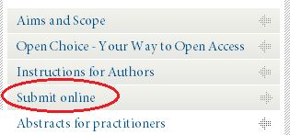
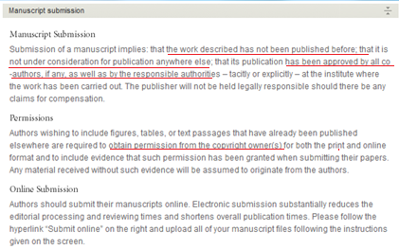
    When you submit
Prepare a cover letter which explains why you think your paper falls within the scope of the journal and which outlines the paper’s originality end/or significance: Unique Selling Points (USP).
Read the guidelines for the journal very carefully and make sure that you conform to these.
Decide what model you want for disseminating your paper: Traditional / Open Access.
NEVER submit your paper to more than one journal at the same time, that would be violating Publishing Integrity.
Notes:
AQ: point 1 – this is nolt mandatory for all the journals

Slide 19
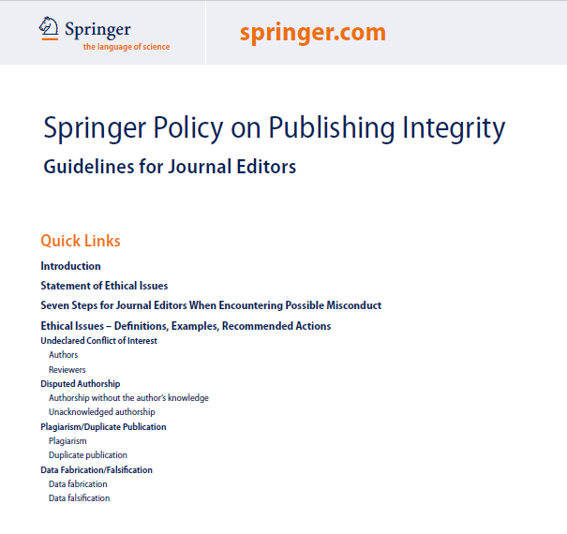

Submission considerations - ethics
The work described has not been published before.
It is not under consideration anywhere else.
Publication has been approved by co-authors and responsible authorities.
Permissions obtained from copyright owners.
NEVER submit your paper to more than one journal at the same time, that would be violating Publishing Integrity.
Avoid data fabrication and falsification

Slide 20
    How to improve your chances of getting accepted
Make sure that the message of your paper is very clear, and that it is very clear in the abstract.
Is the content important and is it offering something new?
Is your paper really relevant to the scope of the journal to which you are submitting?
Check the publication times of the journal you are considering.
Plan your research and writing to meet the quality assurance criteria that the editors and the reviewers of the journal have requested.
Make sure that the science that supports your research is valid and supports your conclusions.
Work on your writing style. Clear and concise is good. If English is not your native language, ask a native English speaking colleague to proofread your paper.
Refine your skills by reviewing papers of colleagues. This will help you form a strong framework for your own research writing.
Notes:
* Spiegare cosa è x springer il backlog. Springer gets rid of the back-log at the end of each year

Slide 21
    Impact Factor
There is much debate over Impact Factors in the scientific community, particularly with regard to the fairness of the system. However, there is no doubt that an Impact Factor is seen as a benchmark of quality of the journal in many academic communities.
Formula:
Number of citation in 2011 to articles published in 2009 + 2010
2011 IF = -----------------------------------------------------------------------------------
Total citable articles published in 2009 + 2010
ISI Impact Factors are calculated from monitoring about 8,000 journals.
SCOPUS Impact Factors are calculated from monitoring about 16,000 journals.
Notes:
AQ

Slide 22
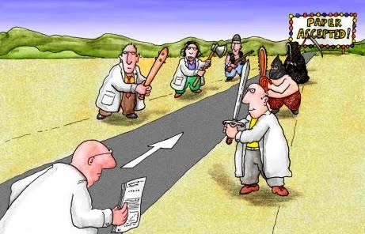
Peer review

Slide 23
    Peer review
Peer review is a process of self-regulation. When you submit an article,
other experts in the field evaluate your article, your research and
methodology, to determine if your paper is suitable for publication.
Peer review is employed to maintain a high quality standard of published
  papers and to provide credibility.
Nearly every manuscript requires revisions, often two or three revisions.
If you receive reviewer comments for re-submission, ACT on them.
Consider peer review feedback as advice to help you improve your article. Do NOT take offense.
Minor revision does not guarantee acceptance after revision. Address all comments carefully.

Slide 24
Publishing timeline
Submission to publication, 3–12 months
Manuscript submitted
Editor assigned rapid rejection or peer review
Editor sources reviewers
Reviewers evaluate accept, reject or revise
Revise manuscript
Reviewers evaluate accept
Publication!
Do not be disheartened if you receive a rejection. It may be that the journal you submitted to simply has a high rejection rate.
Notes:
A lot of people are unaware of the actual time it can take to get a journal manuscript published. On this slide I have said it is somewhere between 3 to 12 months. Now, this is a VERY ROUGH guide. The actual time it can take will depend on many factors – it could depend on the type of manuscript you have written, the turnaround time and publication frequency of a journal will affect the time to publication, the availability of peer reviewers.
The basic process is that you submit your manuscript to your target journal. An editor is then assigned to your manuscript and they make the initial decision as to whether your manuscript is possibly suitable for the journal and should go on to peer reviewers for further evaluation of its content. In almost ALL cases, the editors at the journal will then source the expert peer reviewers and these reviewers will evaluate and critique your manuscript. They will recommend to the journal editor if your manuscript should be accepted, rejected or needs to undergo some form of revision. In the case where revision is required, the authors will be given some time to revise their manuscript according to the peer reviewers comments and can resubmit to the journal. Hopefully then, after a lot of hard work, and with a little bit of luck as well, that results in the publication of your manuscript in the target journal of your choice.

Slide 25
    What is ‘Online First’ and why is it important
Once the article has been accepted, it’s sent to production; as it is ready for publication, it will immediately be published online.
This is called ‘Online First’. The article has a DOI number (a Digital Object Identifier) and can now be read and cited. For example: DOI: 10.1007/s10681-012-0632-1
What the article does not yet have are page numbers and an issue number. This will only be assigned once it is included in the next available or appropriate issue.
Once the issue has been compiled it will be published in print.

Slide 26
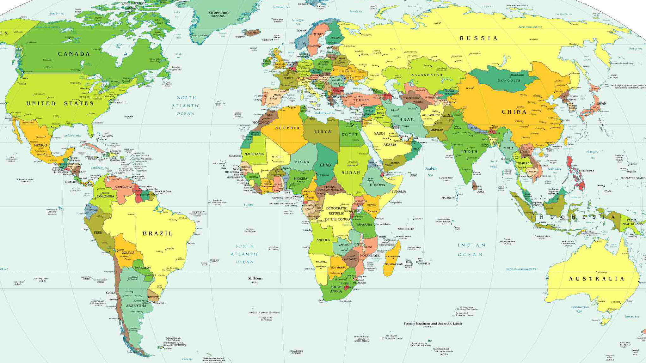
Global Work Flow with Springer
Author
EIC
1
ZIP
2
Δ PDF
3
Correct
Springer HD
4
XML
6
HTML
5
PDF
Meta Data
SPS

Slide 27

Open Access
The article is universally available, FREE to the reader.
Copyright remains with the author.
Author grants publisher the license to publish the article and indentifies the publisher as the original publisher.
Author also grants any third party the right to use the article freely, as long as its integrity is maintained and its original authors, citation details and publisher are identified. Creative Commons: “The author or copyright owner irrevocably grants to any third party, in advance and in perpetuity, the right to use, reproduce or disseminate the research article in its entirety or in part.”
Article processing charge: to be covered by fundings
In case of Springer the fee can be
  paid via research grant or other funding
  paid by a member institution (currently 379 institutions, in 42 countries have a membership with BioMed Central / SpringerOpen. Check with your library!)
  waived (economic hardship, invitation from EiC)

Slide 28
Open Access vs Traditional Publishing
Traditional journals are subscription based, and provide access to subscribers only: Reader pays.
Open Access journal have no subscription barriers: Article processing charges.
Open Access allow authors to retain copyright over the work.
Traditional journals request copyright is assigned to the publisher or journal owner, but allow
  to use all or part of the work in other publications or for educational or research purposes
  to post an electronic version on the final authors’ version on the author’s website and/or in an institutional repository
(note: different publishers have different policies!)

Slide 29
Open Access by subject
(Bio)Medicine was the field where Open Access rooted most naturally because of eg. the NIH.
Most Open Access journals are still in Health Sciences, but other fields are catching up fast.
Source: http://www.doaj.org • date: January 25, 2012

Slide 30

Books
I have an idea for a book. Where should I start from??

Slide 31
    Different types of books
Monographs
  Single author, high quality, niche subject
Contributed volume
  Editor(s), multiple chapter authors
Proceedings
  Proceeding are collected papers from a conference
Textbooks
  Written for a specific higher education course
Reference Works, Encyclopedia, Handbook or Atlas
  Comprehensive and complete
  A-Z format

Slide 32


    Unique to Springer
SpringerBriefs (link)
  Providing a format for publishing research, longer than an article, shorter than a book
  Between 50 and 125 pages
  Organized in focused subject series
SpringerReference (link)
  Dynamic platform with updates, much like WikiPedia (but peer reviewed)
  Final Reference Work on SpringerLink and available in print

Slide 33
When you publish your book with Springer
All books available as eBook and/or traditional print (POD = Print on Demand).
Simple, easy procedures.
Proposals are externally reviewed.
Springer carries out all the typesetting, formatting, etc.
Springer Editors guide you through the process.
Publishing with Springer doesn’t cost you anything.
Complementary copies for participating authors and editors.
33% discount on all other Springer books.
When you submit a book (proposal)
Submit proposal to Publishing Editor
Book proposal review
Invite authors, prepare manuscript
Submit manuscript
Editing, typesetting and formatting
Print proofs: minor changes and corrections
Book published!

Slide 34
Springer helps you from A to Z
Online Article Submission – Online submission and review system primarily used are “Editorial Manager” or “ManuscriptCentral” (depending on the journal). Authors have their own account on springer.com to track their submissions.
MyPublication –In MyPublication you can set your administrative preferences like whether you wish to publish the article Open Access or through traditional publication. Whether the article contains color figures or not and here you can order off-prints and a poster for your article. Finally you sign up for Article Tracking to stay informed of the next steps.
Article Tracking - Once the article has been submitted and accepted for review, the Article Tracking helps you through the process in 7 steps, you will receive email notifications and will also inform you when you are required to do something such as approve proofs. Article Tracking will inform you once the article is published ‘online first’ and when it is published in print.
Satisfaction Survey – you will be asked to complete a short survey to help us to improve our services.

Slide 35

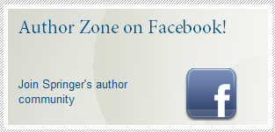
Springer for Authors
A number of years ago Springer established a marketing department that would only be concerned with the needs of our authors. Many tools are at your disposal, to name a few:
Author Homepage (link) – dedicated page on springer.com to answer to all needs you, as an author, may have.
AuthorZone (link) – a regular newsletter full of tips and interesting news for our authors. Follow the AuthorZone on facebook (http://www.facebook.com/AuthorZone) or Twitter (http://twitter.com/#!/authorzone).
Author Academy (link) – a dynamic platform to answer all questions you may have as a new or as an experienced author.
Rights & Permissions (link) – Do you want to do more than just cite another publication? Do you wish to re-use published material? You may want to check with the Rights & Permissions department what the possibilities are.
Notes:
pdf/scrivetemi che ve la mando

Slide 36
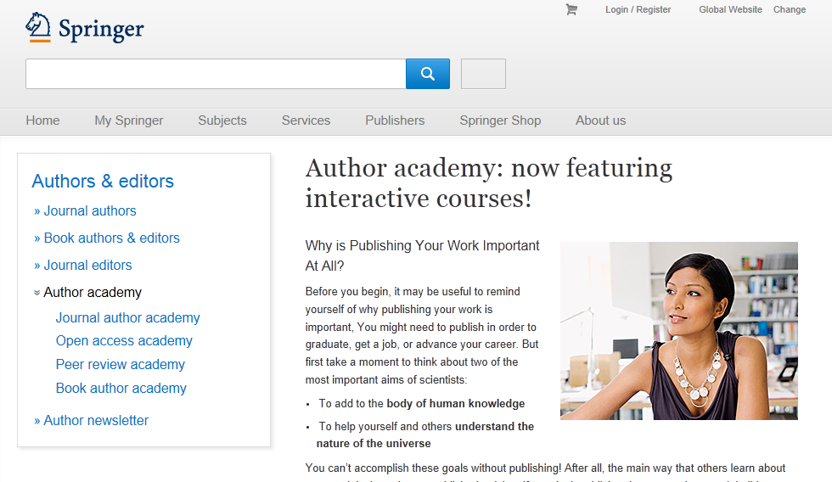
springer.com
Notes:
A lot of the information presented to you here today is actually already freely available to you … at the Springer Author Academy
Go to our website and you can read through all the sections, at your own pace, covering many aspect of scientific publishing. There are plenty of examples to outline the concepts presented, as well as hints and tips to assist you with your writing.

Slide 37

Language editing with Edanz
Edanz is an external company, independent of Springer. Using an editing service is neither a requirement nor a guarantee of acceptance for publication. Edanz will charge authors directly for these language polishing services, please visit their website for more information (link).
Edanz works with expert scientific editors; English editing for scientists, by scientists.
Edanz aims to provide services to raise your chances of acceptance and to ensure clear communication of your research.
Edanz can help you with:
  language editing, development of your abstract and with writing an effective cover letter
  advise on your journal selection
  an expert scientific review of your manuscript (similar to a peer review) before you submit to your target journal
  interpreting the peer review comments, and assess whether the changes you have made are sufficient to satisfy a peer-reviewer
Notes:
Edanz can help you with language editing; advising you on journal selection; provide an expert scientific review of your manuscript (similar to a peer review) BEFORE you submit to your target journal. If you are having difficulty developing your Abstract, they can help, assistance with writing an effective cover letter. And when you’ve submitted a manuscript and it’s gone through peer review, many authors struggle with interpreting the reviewers comments and putting together a point-by-point response. The experts at Edanz can help you interpret these comments, and assess whether the changes you have made are sufficient to satisfy a peer-reviewer, because a lot of the expert editors at Edanz have acted as peer reviewers themselves.

Slide 38
Author Marketing @ Springer
Step by step guidance with article submissions.
Once your work is published, you will receive a congratulation email with tips & tools for self promotion, such as a PDF flyer for your book.
Your work available e-first -> instantly available worldwide.
Your book available in print by Print on Demand -> never ‘out of stock’ or ‘out of print’ again’.
Satisfaction Survey to help us to improve our services.
Strength is in numbers: one of the largest publishers in the world means more visibility, more scientist will have access to your work!
More than 5,500 people around the world are focused on publishing YOUR work.
Springer attends more than 650 conference a year.
Dedicated ‘Author Marketing’ team.
Dedicated sales teams, selling directly to the Academic, Government and the Corporate market, but also working with subscription agents and (online) booksellers such as Amazon.

Slide 39
    eBooks on SpringerLink
24/7 access on SpringerLink.
No Digital Right Management (DRM).
Ownership model / No subscription model (your library will not loose access).
Fully searchable PDF and HTML formats, ePub format coming soon.
Indexed by Google, Scopus and many more.
Chapter level approach, with Digital Object Identifier(DOI)
and chapter level abstract.
Electronic Supplementary Materials (ESM)
such as videos and classroom exercises.
Collection 2013 | N.titoli
Behavioral Science | 85
Biomedical and Life Science | 560
Business and Economics | 370
Chemistry and Materials Science | 280
Computer Science | 1.100
Earth and Environmental Science | 285
Energy | 130
Engineering | 775
Humanities, Social Science & Law | 665
Mathematics and Statistics | 535
Medicine | 560
Physics and Astronomy | 325
Professional & applied Computing | 165
 | 5.835

Slide 40


Springer eBooks Archive
100,000 titles available (since 1840)
50% English - 50% German
35 millions of pages/ 120.000 authors
Formats: XML, Pdf; ePub
Notes:
Height: 7 times Empire State Building (1250 feet)

Slide 41


Questions?
Francesca Bonadei
Springer Italia
Via Decembrio 28 - Milano
02/542597.22
francesca.bonadei@springer.com

