Slide 1

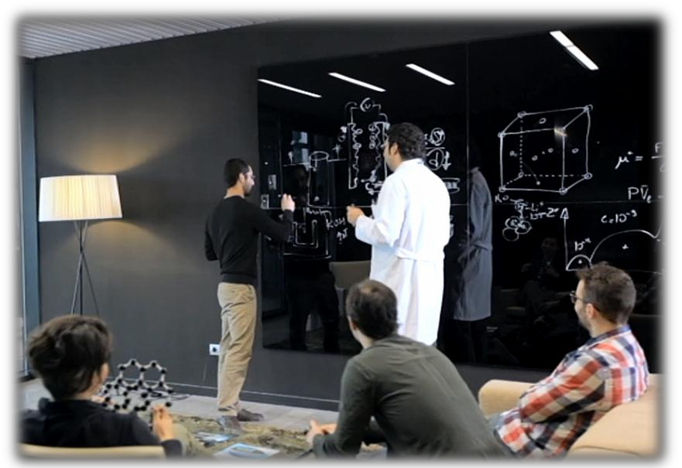
Applications are open to final year university students of related areas: materials science, physics, chemistry, engineering… who wish to develop a career in research. Topics:
Na-based (EES)
Adv. Cathodes (EES)
Polymer rich (EES)
Ceramic rich (EES)
Li S (EES)
Metallic Lithium (EES)
Metal-air(EES)
Supercapacitors (EES)
Sensible heat thermal energy storage materials (TES)
Latent thermal energy storage materials (TES)
Thermochemistry (TES)
HOW TO APPLY?
To manage your application (academic record + CV) please enter your details through our website http://www.cicenergigune.com/en/trabajar/ofertas/
before 10th May 2018
www.cicenergigune.com

